Slide 1
ONLINE COURSES AND EXAMINATION MANAGEMENT [E-Master Web]
By-
Sayed Mizanur Rahman Rimon [2181081017]
Mysha Parvin [2181081144]
Navila Haque [2181081032]
Md. Nayefur Rahman [2181081001]
Mahmuda Akter Marufa [2181081004]
Students of CSE Department, Uttara University

Slide 2
Conducted through the internet.
INTRODUCTION
Management philosopher Peter Drucker forecasted: “Universities won’t survive. The future is outside the traditional campus. Distance learning is coming on fast.”
The era of computer
Monitoring System

Slide 3
BACKGROUND STUDY
Many different researches have focused on the subject of an Online Courses & Examination system these work can be represented as following:
SIETTE (2005)
EMS (2010)
CBTS (2013)

Slide 4
PROBLEM STATEMENT
Wastage of Time
Insecurity
Payments System
Quick Test System
Result Publishing System

Slide 5
Objective
Objective of this initiative is to design, develop and implement a citizen centric and national impacted delivery Platform for all Students and Teachers to ensure accountability & satisfactory services.

Slide 6
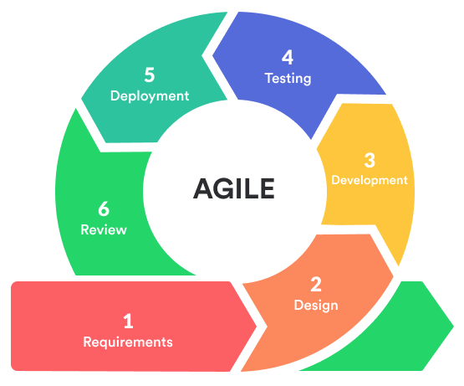
METHODOLOGY
Agile Model

Slide 7
Why do we use AGILE model?
More adaptability (and less risk)
Greater customer satisfaction
Happier teams
Face-to-face conversation with team members and customers
Focuses on technical excellence and good design
Fast and continuous development
Enables collaboration and interaction between client and project team
Faster feedback from customers or end-users
Quick identification and elimination of errors found in the code
Quick delivery of products
Easy to manage with more flexibility

Slide 8
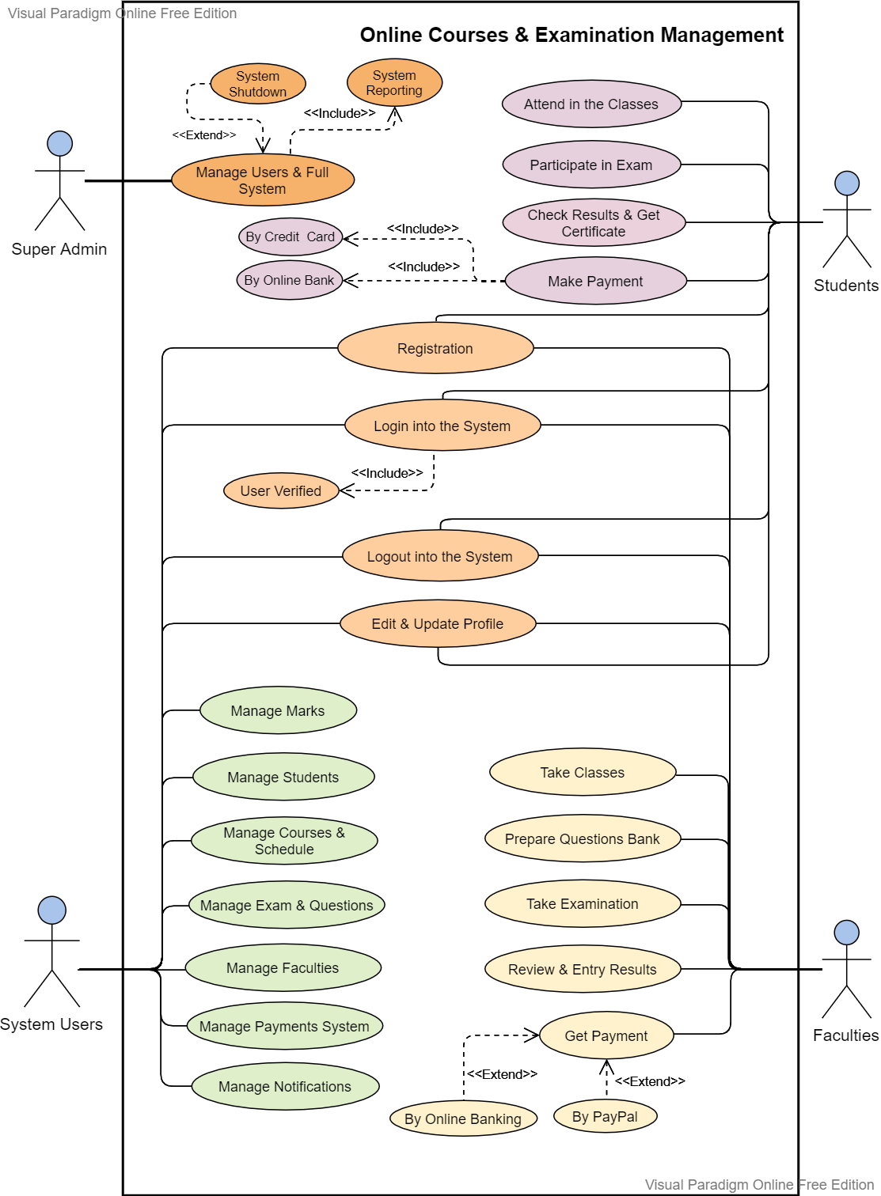
Use Case Diagram

Slide 9
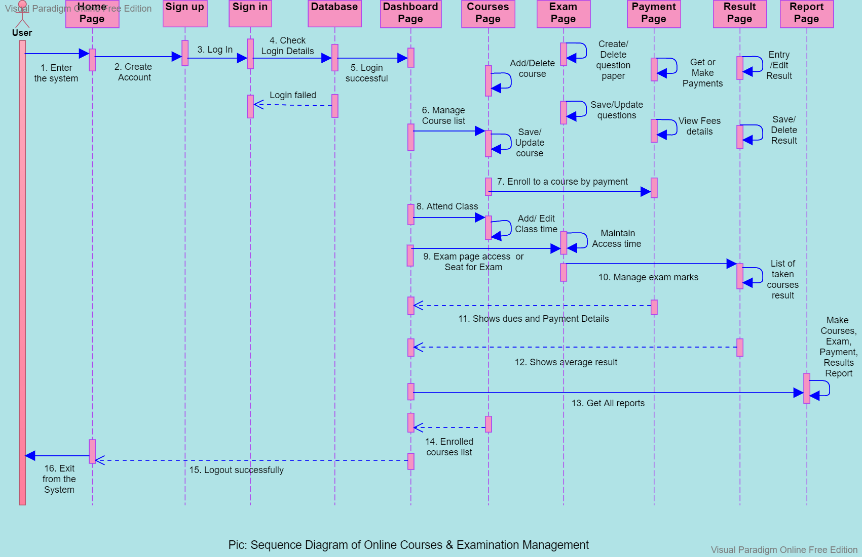
Sequence Diagram

Slide 10
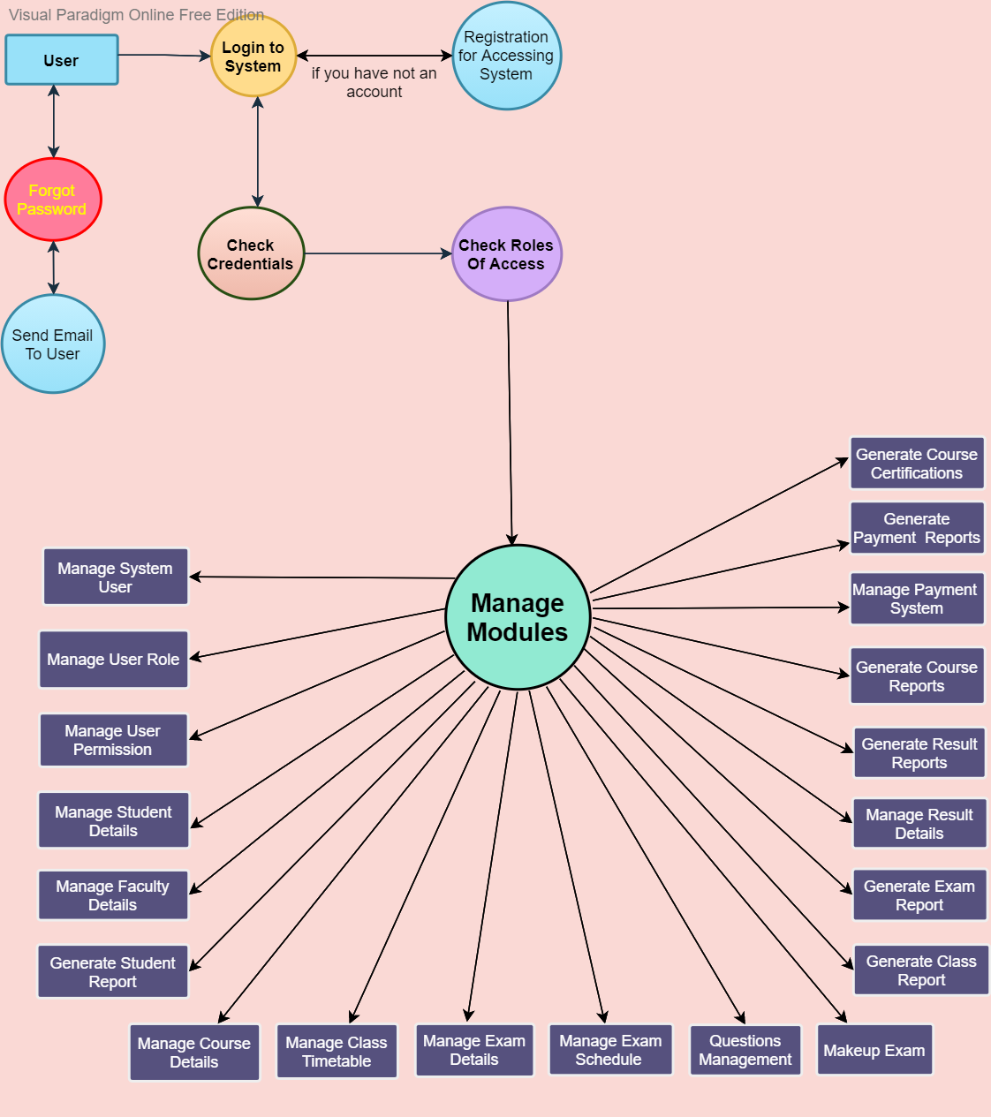
Data Flow Diagram

Slide 11
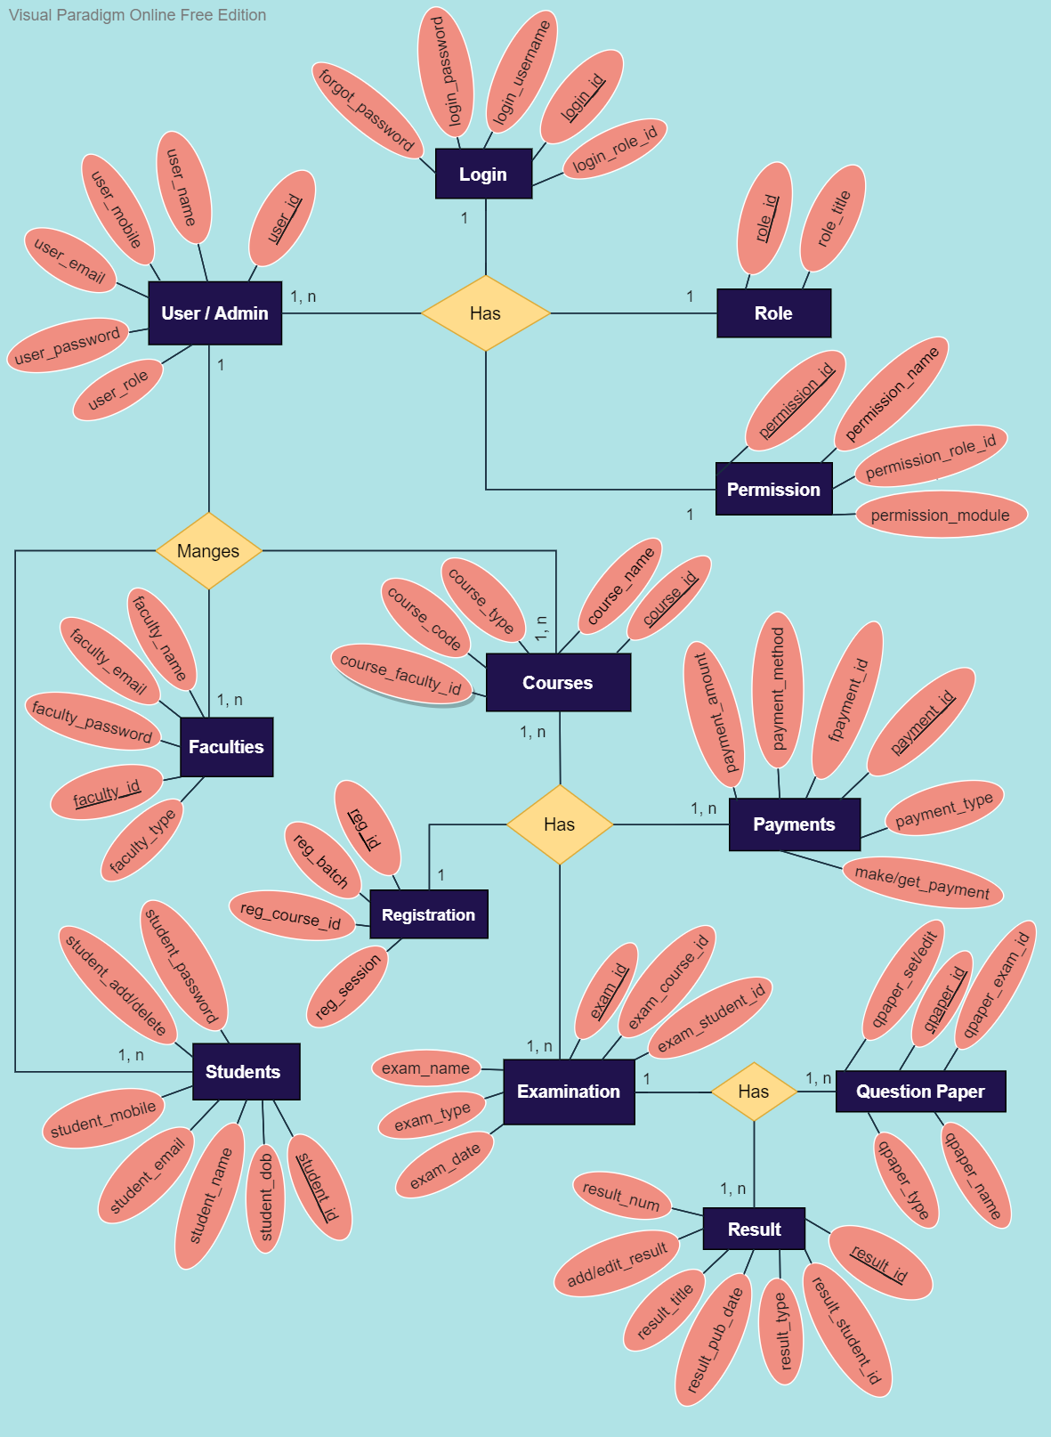
E-R Diagram

Slide 12
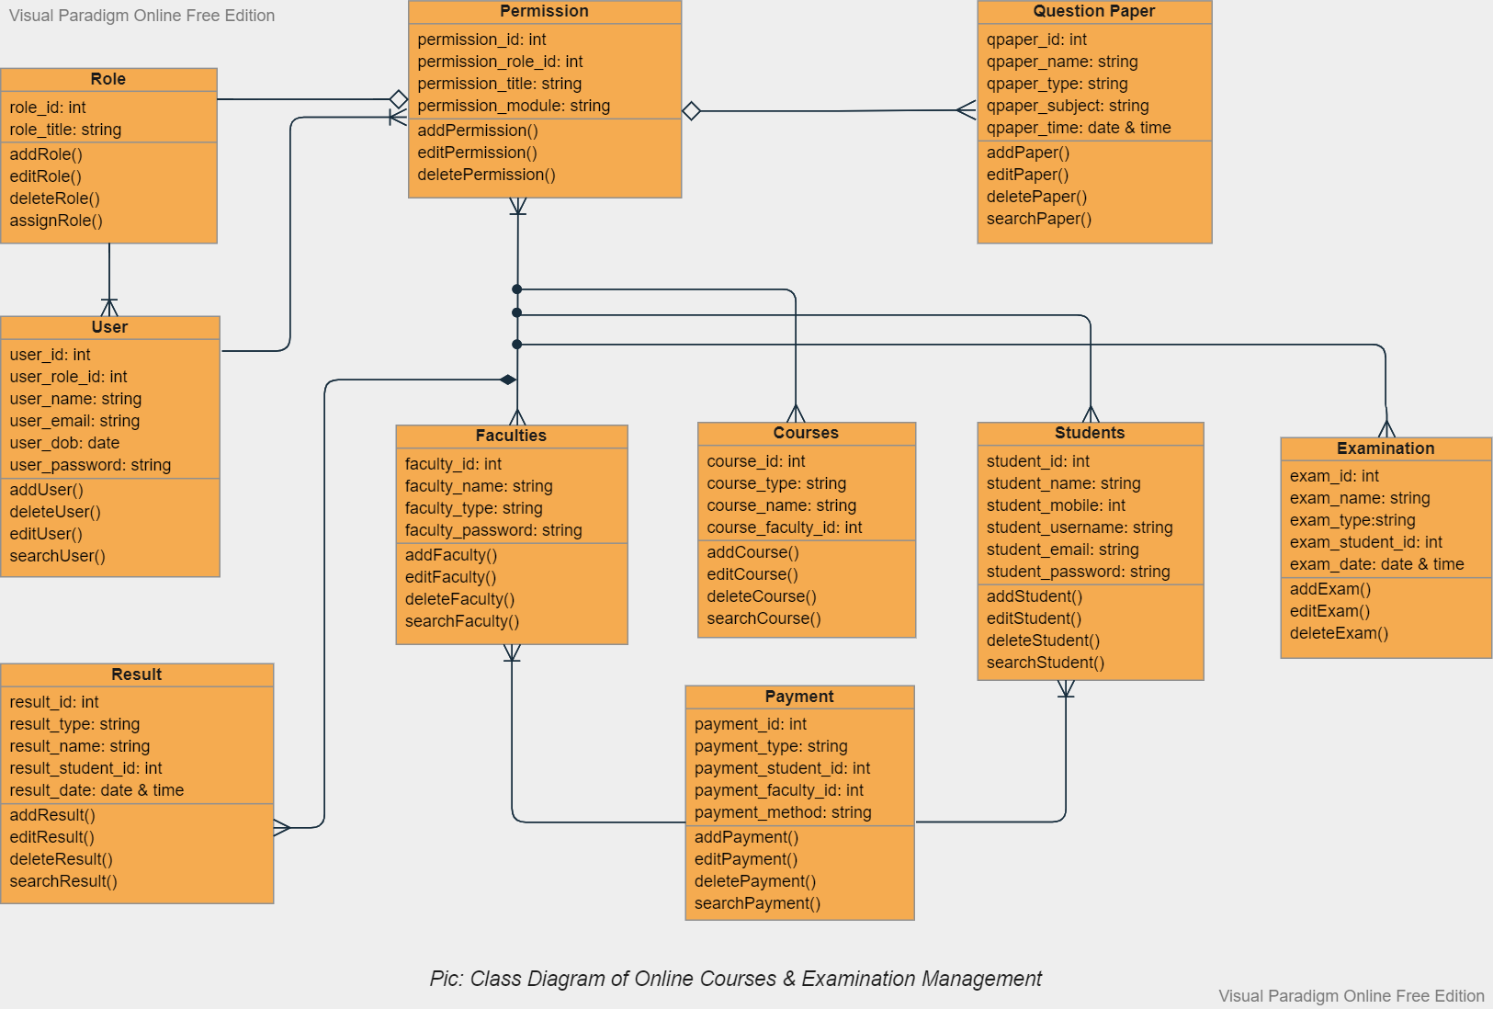
Class Diagram

Slide 13
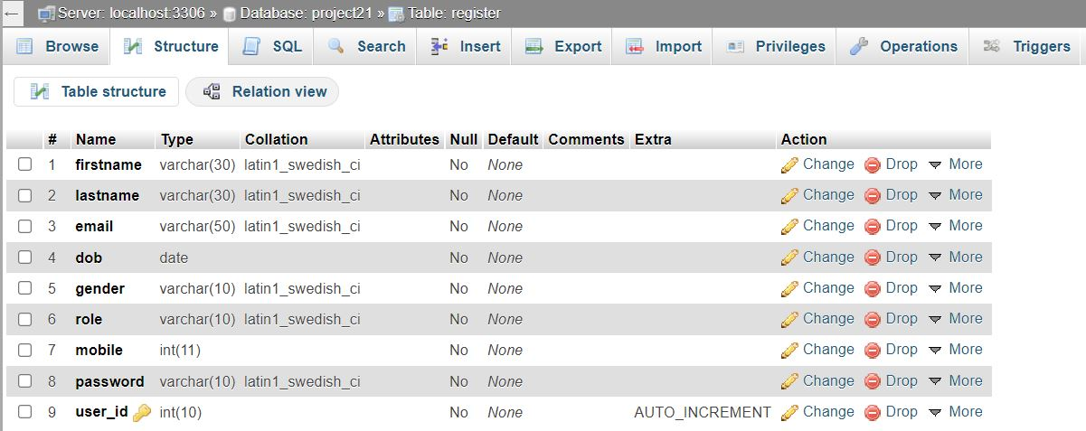
Some Pictures of Database Table

Slide 14
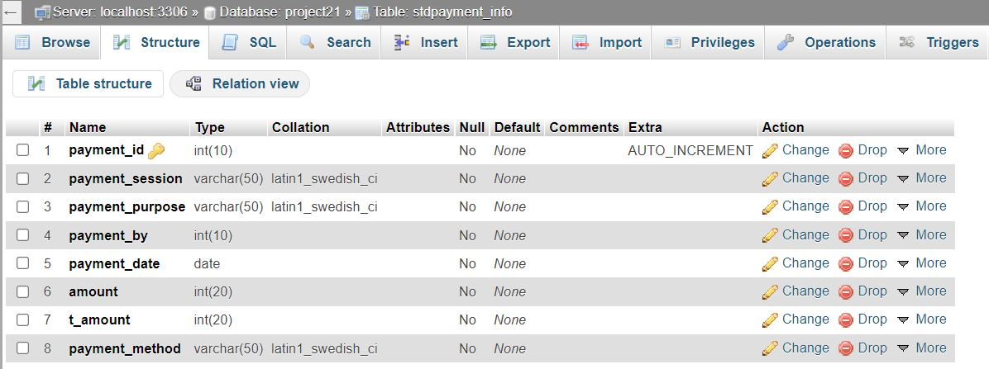
Some Pictures of Database Table (Continued……)

Slide 15
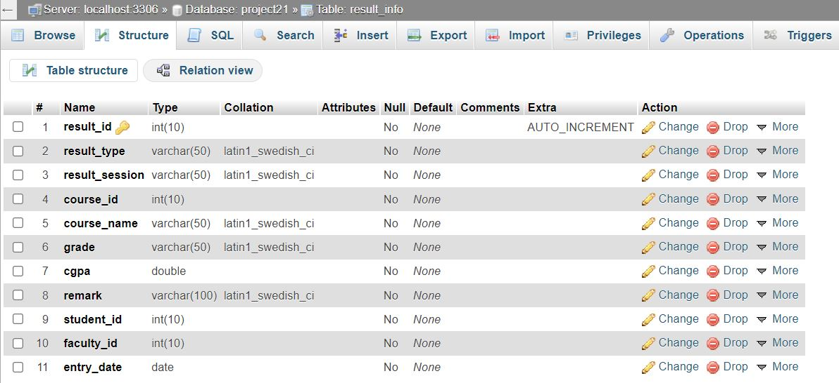
Some Pictures of Database Table (Continued……)

Slide 16
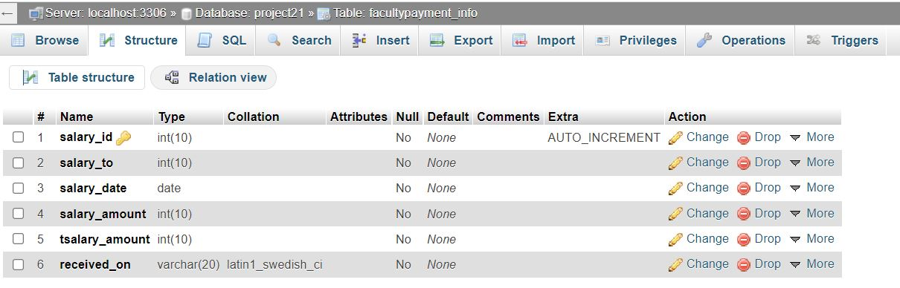
Some Pictures of Database Table (Continued……)

Slide 17
Expected Outcome
Service Recipient (Student & Teacher) | Service Provider (Admin)
Online Profile Adding Or Registration System | Online Profile Adding Or Deleting System
Online Free Registration | Online Profile Detail View System
Online Course Details & Selection | Online Database Management
Online Test Participation System (Students) | Online Course Offering
Online Notice View | Online Notice CRUD System
Online Payment CRUD System | Online Payment CRUD System
Online Result Published System | Online Results System
Specific User Can Update Or Edit The Related Data | Specific User Can Update Or Edit The Related Data

Slide 18
GANTT CHART & RESEARCH MILESTONE
Months | Jan | Feb | Mar | Apr | May | June | July | Aug | Sep | Oct | Nov | Dec
Project Phase
Planning
Design
Coding
Testing
Delivery

Slide 19

Some Pictures of our project Webpages

Slide 20
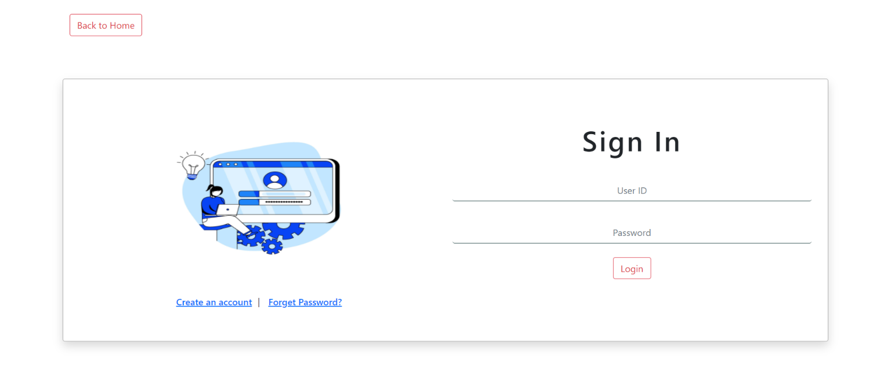
Some Pictures of our project Webpages (Continued…….)

Slide 21

Some Pictures of our project Webpages (Continued…….)

Slide 22
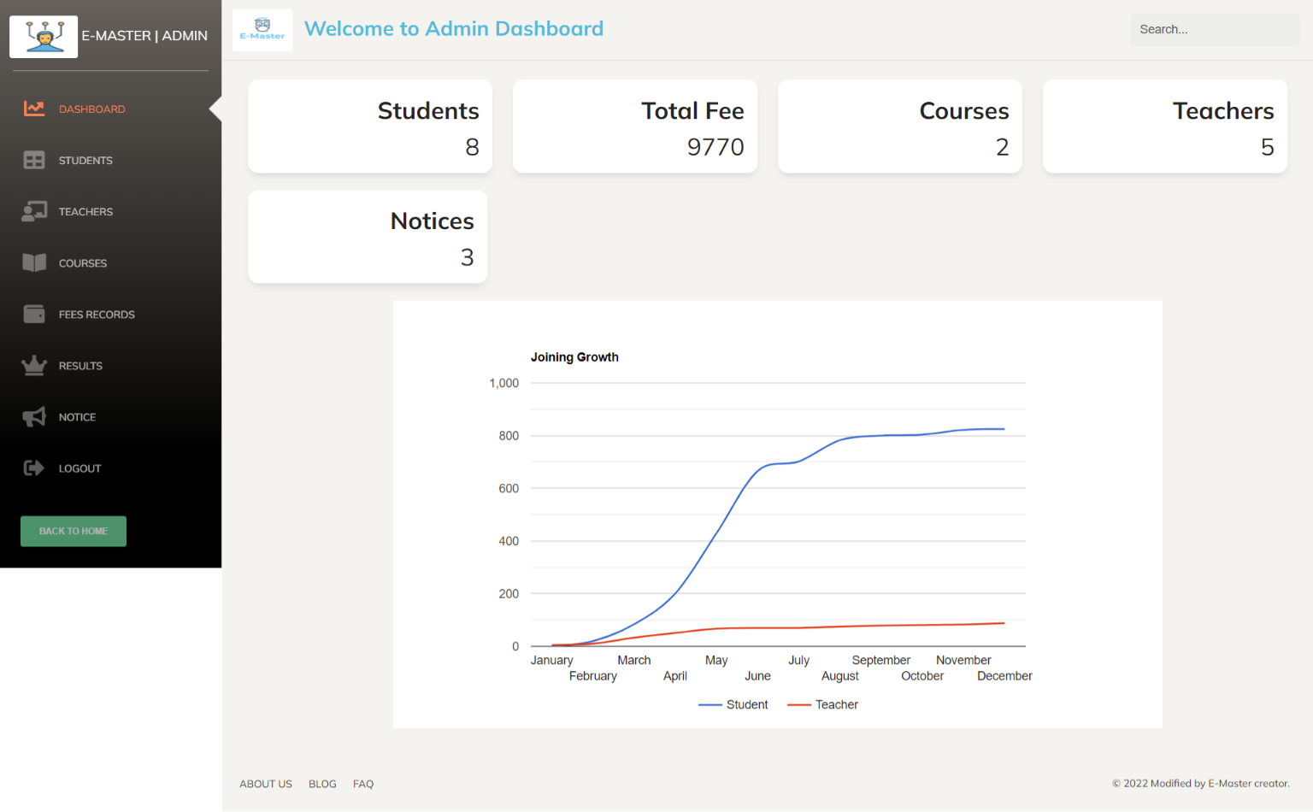
Some Pictures of our project Webpages (Continued…….)

Slide 23
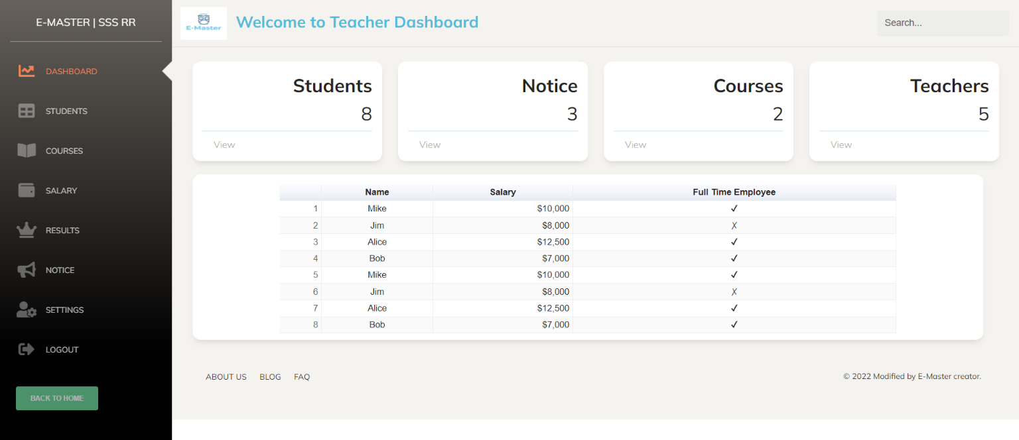
Some Pictures of our project Webpages (Continued…….)

Slide 24
Conclusion
The system provide facility to conduct online examination work wide.
It is automatically generated by the server.
The system is operate at a high level of efficiency.

Slide 25
THANK YOU

